Slide 1
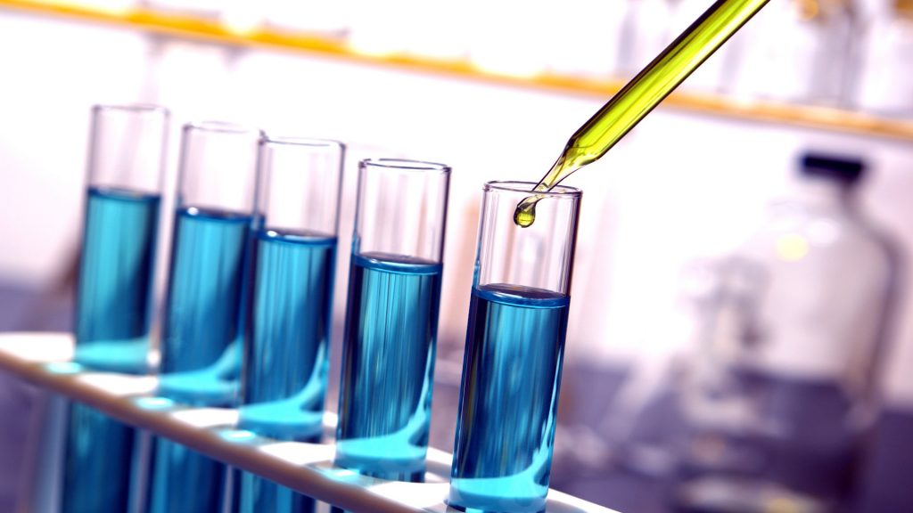
Clinical biochemistry
it is a branch of clinical medicine in which
chemical and biochemical methods are applied to the study of diseas .
Biochemical tests:
Laboratory and diagnostic tests are tools to gain additional information about the patients and they are not therapeutic .
Lab. Test + patient history + physical examination = confirm a diagnosis & provide valuable information about a patients status.

Slide 2
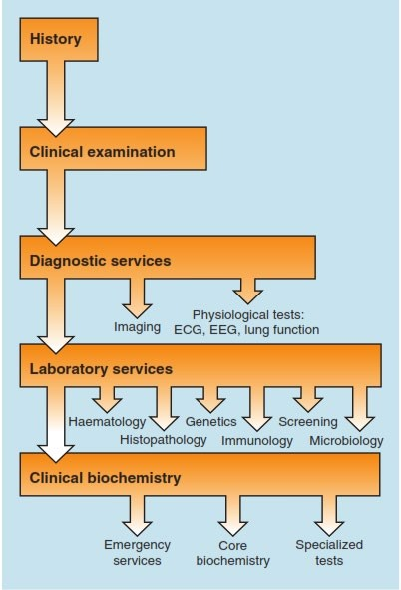
Core biochemical tests:
Glucose
Sodium, potassium and bicarbonate Urea and creatinine
Calcium and phosphate
Total protein and albumin
Bilirubin and alkaline phosphatase
Alanine aminotransferase (ALT) and aspartate aminotransferase (AST)

Slide 3
Specialized tests
Hormones
Specific proteins
Trace elements
Vitamins
Drugs
Lipids and lipoproteins
DNA analysis
Emergency tests
Urea and electrolytes
Blood gases
Amylase
Glucose
Salicylate
Paracetamol
Calcium

Slide 4
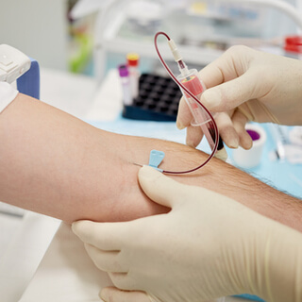
The diagnostic testing process include 3 phases:
Preanalytical phase
Post-analytical phase
Analytical phase
is involves an individual’s preparation for collection of the biological material.
is involves performance of procedure, collection and transport of specimens.
include interpretation of test results and informing the patient, identification of critical values.

Slide 5
Controllable Factors before the Biological Material Collection or during sampling:
1. Age related differences:
these include for e.g :bilirubin in the neonate and plasma ALP activity Alkaline Phosphatase, higher in children and the elderly.
2. Sex related differences:
for e.g: plasma urate which is higher in males, and HDL cholesterol, which is higher in premenopausal women than in men.

Slide 6
3. Ethenic differences:
for e.g: CK may be higher in black than in white people.
4. Oral medication:
blood should be taken for a drug assay at a standard time after the dose e.g: thiazide diuretics cause significant hypokalemia due to rapid clearance of K from extracellular fluid ECF,
Oral contraceptive pill cause increase in hormone binding protein and lipids, morphine causes an increase in liver and
pancreatic enzyme.

Slide 7
5. Iron:
in males more than females mainly because of the menstruation and pregnancy.
6. Creatinine:
M more than F because the muscle mass in M higher than F

Slide 8
Other interfering factors include
1) sampling error
2) patient factor errors
Incorrect specimen collection, handling, storage or labeling.
Haemolysed specimens
Delayed specimen delivery
Old or deteriorating specimens
incorrect pre-test dite
patient illness
current drug therapy
dehydration
position of patientat time of specimen collection
stress

Slide 9
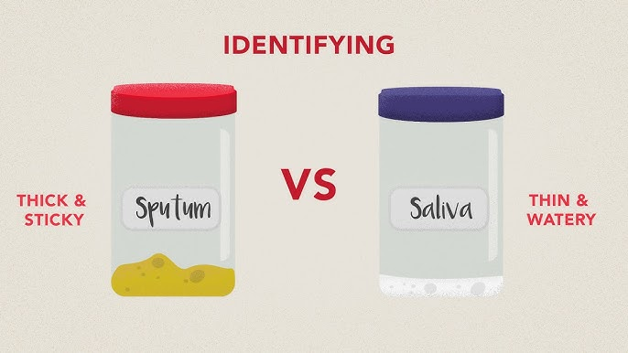
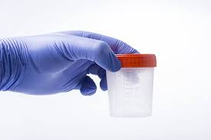
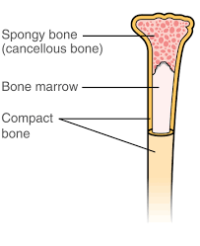
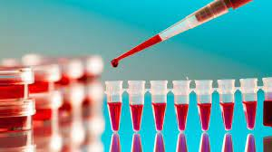
Types of biological specimen:
blood (whole, plasm, serum)
urine
stool
saliva, sputum
biological fluids (peritoneal, synovial, cerebrospinal, amniotic, hair, skin, tissue, semen)
bone marrow

Slide 10
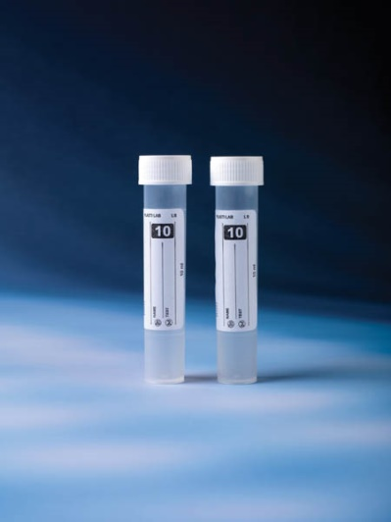
Types blood collection tubes:
Blood collection tubes have color-coded stoppers to indicate the presence or absence of different types of additives (preservative or anticoagulant). A preservative prevent change in the specimen and anticoagulant inhibits clot formation or coagulation.
White-top (plane) tubes
White-top tubes, also known as plain tubes or serum tubes, are a type of blood collection tube used in clinical laboratories to collect blood samples for various diagnostic tests. These tubes do not contain any additives or anticoagulants, and they are primarily used for tests that require serum, which is the liquid portion of blood that remains after coagulation (blood clotting) has occurred .

Slide 11
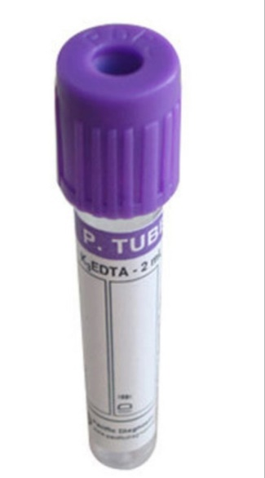
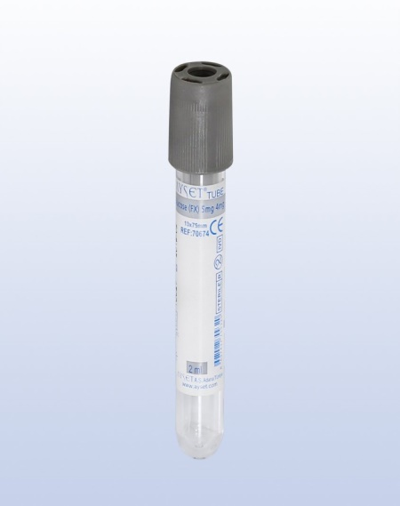
Lavender-top tubes
also known as purple-top tubes, are a type of blood collection tube used for specific purposes, primarily to collect blood samples for hematological tests. These tubes contain the anticoagulant ethylenediaminetetraacetic acid (EDTA),used for hematological studies used for plasma collection
Grey-top tubes
also known as gray-top tubes, are a type of blood collection tube used for specific purposes. These tubes are distinct because they contain a combination of two additives: sodium fluoride and potassium oxalate. The primary function of grey-top tubes is to inhibit glycolysis, because fluoride inhibit blood glucose conversion to lactic acid. ( for blood glucose measurement ).

Slide 12
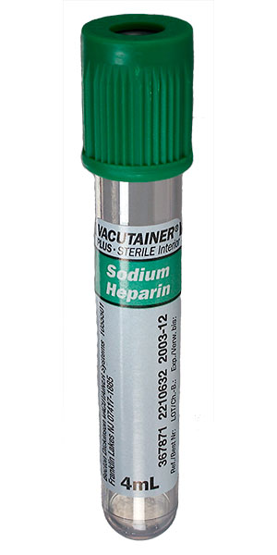
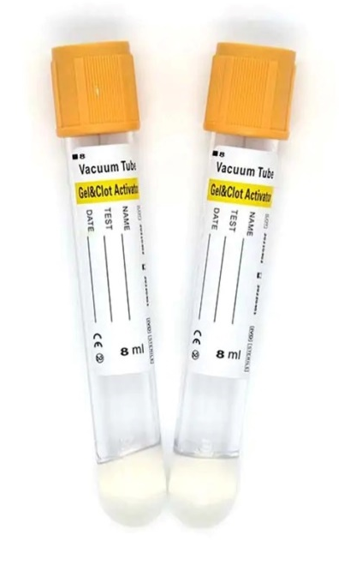
Green-top tubes
these contain heparin used for plasma collection
Yellow top tube
contain a clot activator used for serum collection(SST) .

Slide 13
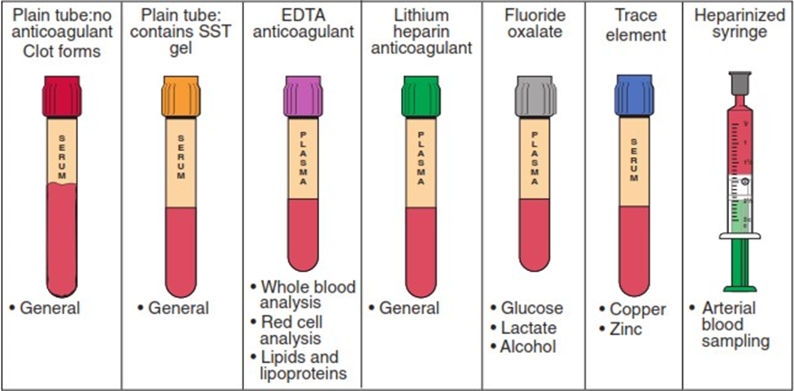
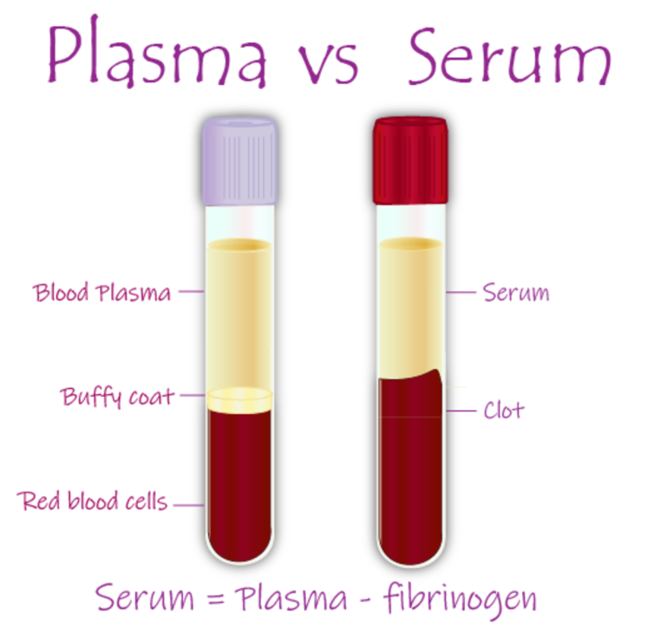

Slide 14
Plasma
Plasma is the liquid component of blood that remains when blood cells (red blood cells, white blood cells, and platelets) are removed. It makes up about 55% of the total volume of blood.
Plasma contains water, electrolytes (such as sodium and potassium), hormones, waste products, and proteins, including clotting factors (like fibrinogen) and albumin.
Plasma is typically collected by anticoagulating the blood, usually with a substance like heparin or EDTA, to prevent it from clotting. This ensures that the liquid portion of blood remains in its liquid form.

Slide 15
Serum
Serum is the liquid portion of blood obtained after coagulation has taken place. In other words, it is plasma from which the clotting factors (such as fibrinogen) have been removed.
One of the primary reasons serum is preferred for certain laboratory tests is because it does not contain clotting factors that can interfere with test results. The absence of clotting factors in serum makes it a more suitable specimen for various biochemical and diagnostic assays.

Slide 17
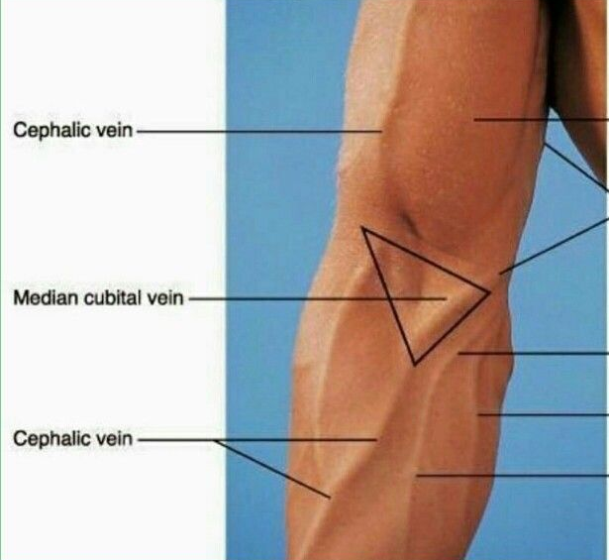
Venipuncture: or called phlebotomy
Is the process of obtaining a blood sample from a vein using a needle attached to a syringe or syringe stopper evacuated tube. Venipuncture allow collection of larger quantities of blood for testing usually, the antecubital vein, the vein of choice because of ease of access.

Slide 18
Urine specimen
Urine test are easy to obtain and provide valuable information about many body system functions such as kidney function, glucose metabolism and various hormone level .Urine specimen containers may include a preservative to inhibit bacterial growth, or acid to stabilize certain metabolites. They need to be large enough to hold a full 24- hour collection.

Slide 19
Stool specimen
The examination of feces provides important information that aids in the diagnosis of various GI disoreders. Fecal tests may include microbiological, chemical or parasitic examination.
Guidelines
Collect a stool specimen in a clean container that has a fitted cover
Do not mix urine and toilet paper with the stool specimen
Correctly label and deliver stool specimens to the lab. Within 30 min. after collection, otherwise, the specimen should be refrigerating.

Slide 20
Types of puncture
Arterial Puncture: it is reserved for blood gases evaluation and emergency situation and performed by those with special training because arterial puncture is dangerous and difficult.
Venous Puncture: it is affected by metabolic activity of the tissues.
Capillary Puncture(skin puncture): it contain arterial and venous blood plus tissue fluid , its composition differ from venous blood, capillary glucose is often higher while Ca, K, & total protein are lower than in venous blood. More appropriate site is fingerstick or heel puncture in infants.

Slide 22
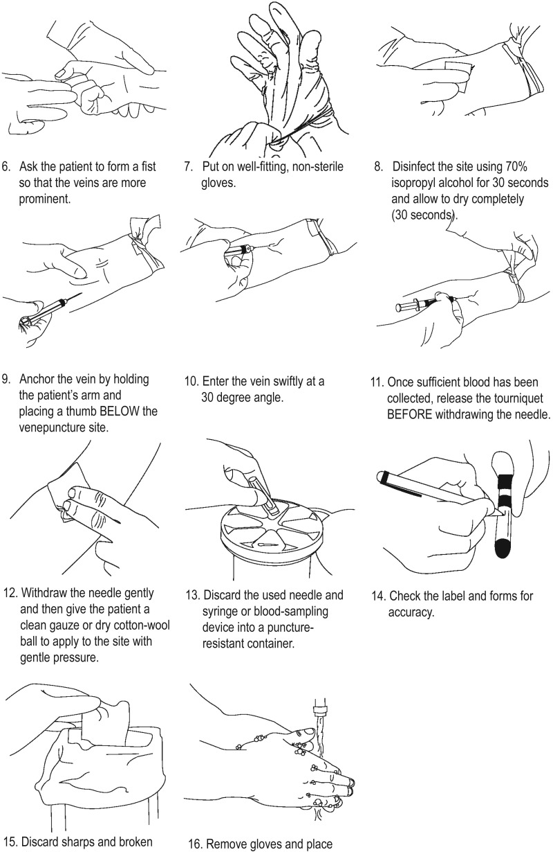

Slide 23
Important guidelines:
To obtain valid results do not apply the tourniquet for longer than 1 min. (prolong tourniquet application can cause blood stasis and hemoconcentration).
Do not shake the blood specimen , hemolysis may result from vigorous shaking and invalid test results.
After the specimen is drawn, apply pressure to the vein puncture site to avoid the bleeding.
If the patient fasted before the blood test, reinstitute appropriate diet.

Slide 24
Thank you

